Slide 1
Milk Stocking Inventory Analysis
MIS 64018: Quantitative Management Modeling
Presentation
Presented By: Steve Spence, Charity Elijah, Cameron Croghan
Steve Spence, Charity Elijah, Cameron Croghan

Slide 2
Agenda
Introduction and Motivation
Problem Statement and Project Objective
Data Sources and Modeling Methodology
• Scope
• Decision variables
• Constraints
• Modeling Strategy
• Analysis
Experimental Result
Conclusions
Steve Spence, Charity Elijah, Cameron Croghan
Notes:
Presentor: Charity

Slide 3
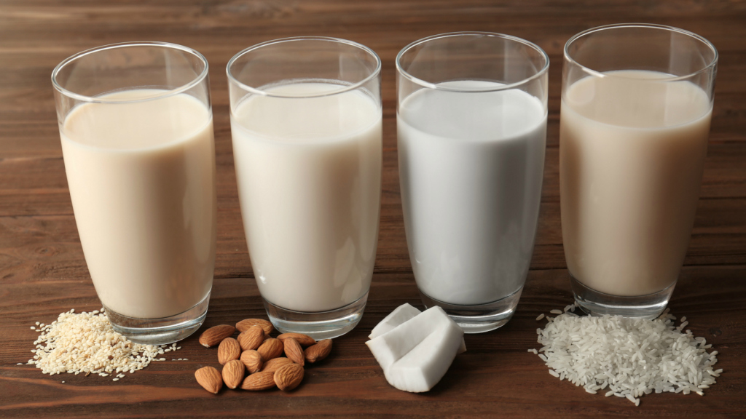
Introduction & Motivation
Cow milk is a staple in significant portion of the population’s diet
Plant-based milk is gaining larger sales in the market due to:
Health and diet trends
Environmental reasons
Taste and flavor
Grocery stores are experiencing larger amounts of wasted, unsold milk
Steve Spence, Charity Elijah, Cameron Croghan
Notes:
Presentor: Charity
For a very long time, dairy milk has been a staple from which much needed calcium and growth supporting nutrients are sourced.
More recently, non-dairy products have progressively gained consumer preference. Non dairy milk has a number of advantages over the dairy milk largely due to its tolerance level in many consumers.
Oat milk
Rice milk Legume-Based
Soy milk
Pea milk Vegetable-Based
Potato milk Seed-Based
Flax milk
Hemp milk Nut-Based
Almond milk
Cashew milk
Coconut milk
As a result, retail outlets find themselves struggling with optimum stocking levels for dairy products to avoid wastage and oversupply.

Slide 4
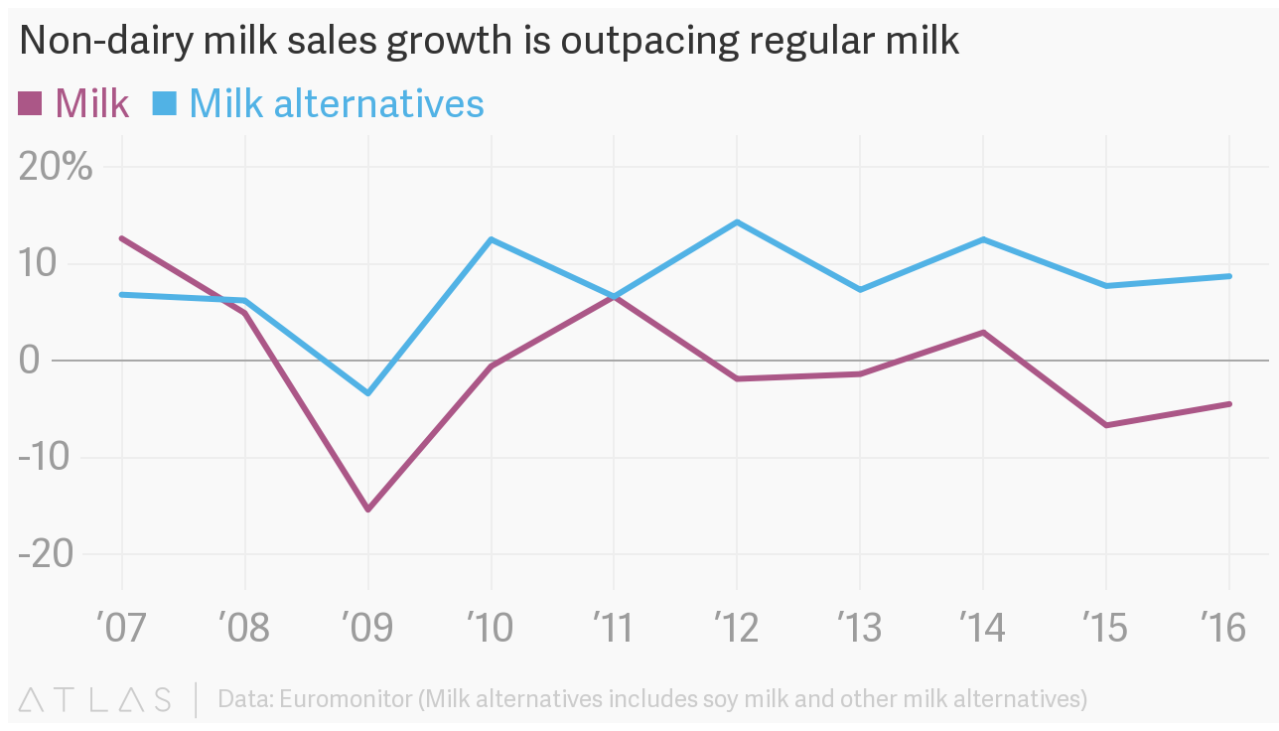
Introduction & Motivation
Steve Spence, Charity Elijah, Cameron Croghan
Notes:
Source: https://www.theatlas.com/charts/ryyFOzLql
Presentor: Charity

Slide 5
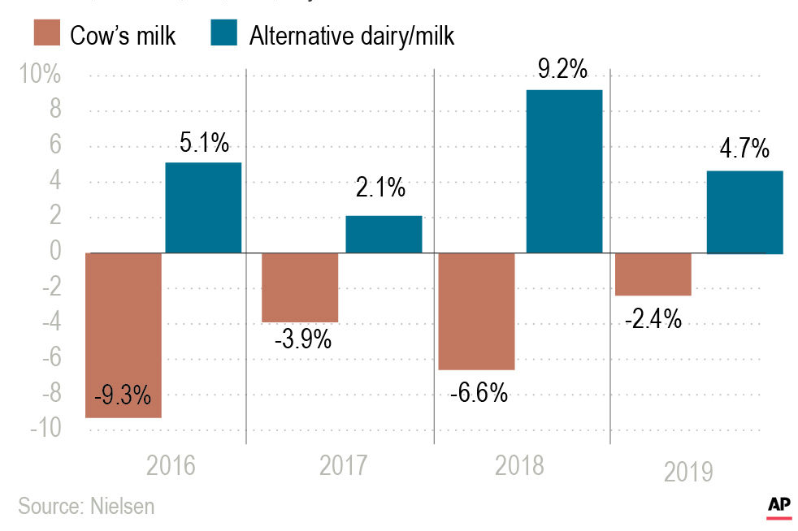
Introduction & Motivation
Steve Spence, Charity Elijah, Cameron Croghan
Notes:
Source: https://www.kenoshanews.com/agriculture/major-milk-company-declares-bankruptcy/article_704b35ea-4cf5-5fd2-832b-13a276e9293c.html
Presentor: Charity

Slide 6
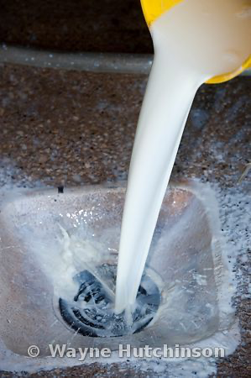
Introduction & Motivation
Milk waste has several sources:
Production
Distribution
Storage
Overproduction
Shelf Life
Over 43 Million gallons dumped by U.S. farmers in 2016 due to overproduction
Steve Spence, Charity Elijah, Cameron Croghan
Notes:
Presentor: Charity

Slide 7
Problem Statement and Project Objective
Problem Statement:
Due to changes in market trends and overproduction, farmers and retailers are experiencing large amounts of waste from overproduction.
Project Objective:
Determine the optimal yearly product mix to maximize sales dollars for retailers while minimizing expired, unsold milk.
Steve Spence, Charity Elijah, Cameron Croghan
Notes:
Presentor: Charity
Given the disproportionate demand for non-dairy milk over dairy milk, retailers would like to know what quantity of dairy milk to carry as inventory relative to the non-dairy milk. And so we set out to answer the question;
Given the demand for non-dairy milk, what quantity of dairy milk should a retail outlet carry?
The objective is to enable retailers better manage inventory of dairy milk and not over-stock these products resulting in wastage

Slide 8
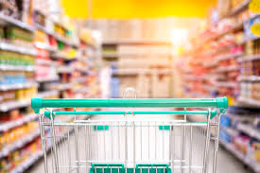
Modeling Methodology
Assumptions for Problem:
Retail store for problem serves a population of 30,000 people
Daily demand/preferences extrapolated from annual data
Shelving space available
Steve Spence, Charity Elijah, Cameron Croghan
Notes:
Presentor: Steve
Retail store simulates Walmart serving southern portion of Kent (~30,000 people)
Annual sales of cow milk were 4.2 billion gallons (roughly 1 to 4 gallons per person based on type)
Annual sales for plant-based milk were 800 million half-gallons (roughly 0 to 2 half-gallons per person based on type)
Shelving space based on visible Walmart count

Slide 9
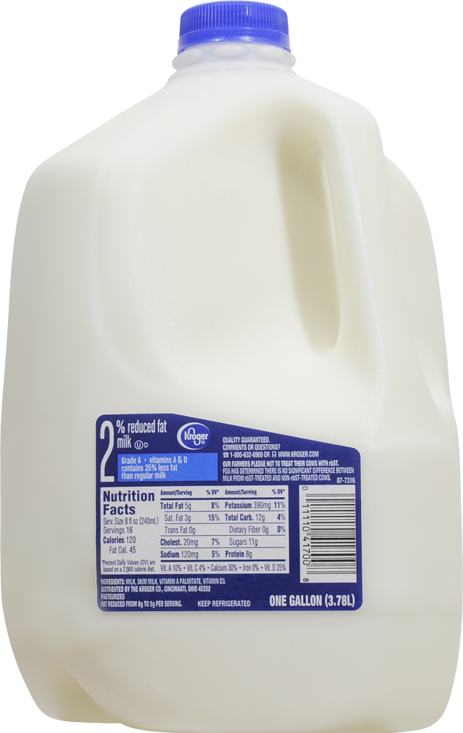
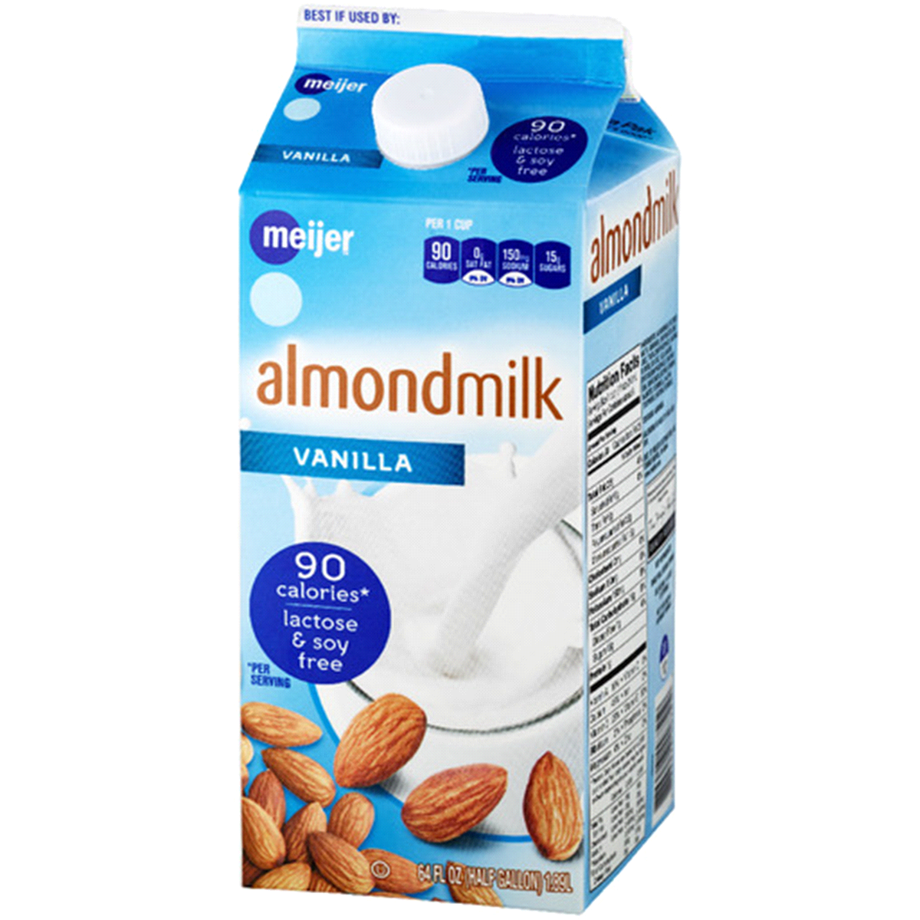
Modeling Methodology
Objective Function - Maximize Daily Sales:
Z = 2.19*X₁ + 2.19*X₂ + 2.19*X₃ + 2.19*X₄ + 1.82*Y₁ + 2.08*Y₂ + 2.97*Y₃ + 3.44*Y₄
X_{i} = Daily # of Gallons of Cow Milk
(Whole, 2%, 1%, Skim)
Y_{i} = Daily # of Half-Gallons of Plant Milk
(Almond, Soy, Coconut, Rice)
Steve Spence, Charity Elijah, Cameron Croghan
Notes:
Presentor: Steve
Objective function is to maximize sales for the store (constraints will limit sales to not exceed demand)
All dairy gallon dairy milks cost the same amount
Plant-based typically sold in half-gallons and prices vary based on type

Slide 10
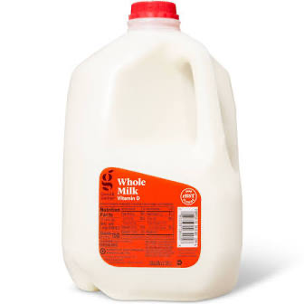
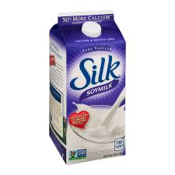
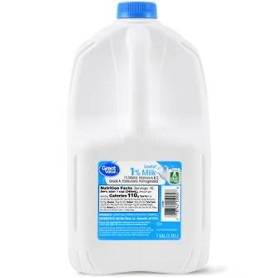
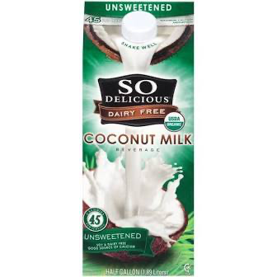
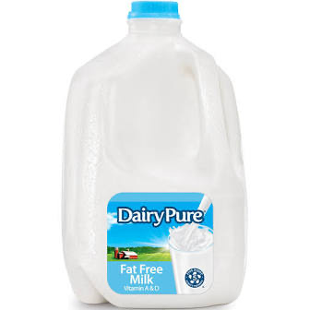
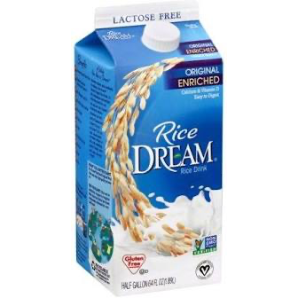
Modeling Methodology
Constraint - Max Daily Demand:
Whole Milk: 357 gallons
Almond Milk: 149 half-gallons
2% Milk: 349 gallons
Soy Milk: 23 half-gallons
1% Milk: 145 gallons
Coconut Milk: 8 half-gallons
Skim Milk: 89 gallons
Rice Milk: 3 half-gallons
Steve Spence, Charity Elijah, Cameron Croghan
Notes:
Presentor: Steve
Maximum daily demand for population of 30,000 based on previously described calculations from annual sales
For the purposes of this analysis, not every type of milk was included (no data available for flavored, organic, other types, etc.)

Slide 11
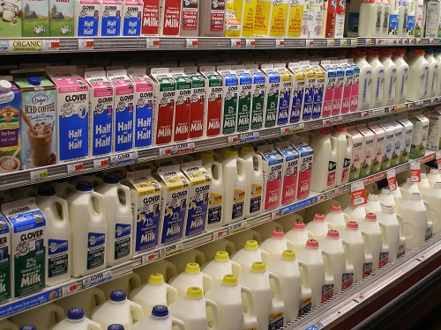
Modeling Methodology
Constraint - Milk Shelving Space:
Gallon Milk Size
30.25 inch²
Half-Gallon Milk Size
14.06 inch²
Shelving Space Available:
24,200 inch²
Steve Spence, Charity Elijah, Cameron Croghan
Notes:
Presentor: Steve
Shelf space could fit: 800 gallons OR 1721 half gallons OR 400 gallons & 860 half gallons
Shelf space assumes 8 coolers available for milk storage, each with 5 racks
Rack surface area available is 24,200inches
Assumption is only for sales of gallon sized cow milk and half-gallon sized plant-based milks

Slide 12
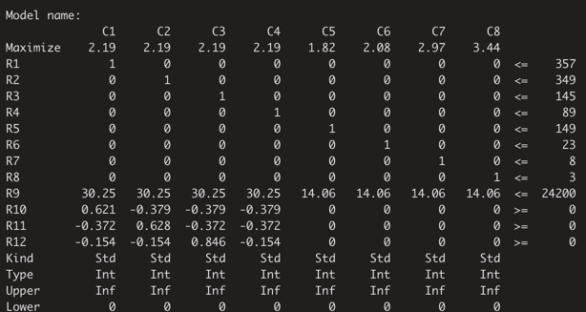
Modeling Methodology
Integer Programming Model Input Overview:
Steve Spence, Charity Elijah, Cameron Croghan
Notes:
Presentor: Steve
Snapshot for our .lp program file for year 1
Includes constraints previously discussed plus proportion constraint for cow milk
Integer programming problem

Slide 13
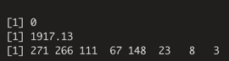
Experimental Results
Model Output:
“0” - Optimal Solution Found
$1,917.13 in Daily Sales
Daily Stocking Levels by Milk Type
Steve Spence, Charity Elijah, Cameron Croghan
Notes:
Presentor: Steve
Output for linear programming problem

Slide 14
Experimental Results
Results - Weekly Order Quantities:
$13,420 in Weekly Sales
Whole Milk: 1,897 gallons
Almond Milk: 1,036 half-gallons
2% Milk: 1,862 gallons
Soy Milk: 161 half-gallons
1% Milk: 777 gallons
Coconut Milk: 56 half-gallons
Skim Milk: 469 gallons
Rice Milk: 21 half-gallons
Steve Spence, Charity Elijah, Cameron Croghan
Notes:
Presentor: Steve
Based on daily stocking levels, the optimal stocking levels on a weekly basis are shown above
Weekly stocking levels are more appropriate for stores, since cow milk has a relative short shelf life (1 to 2 weeks)

Slide 15
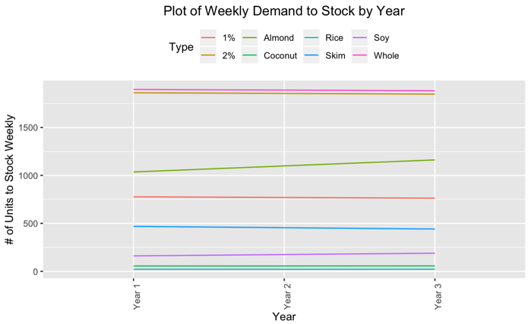
Experimental Results
Single Store Demand After 3 Years:
70 dairy gallons/week
156 plant half-gallons/week
NE Ohio Store Demand After 3 Years:
10,570 dairy gallons/week
23,556 plant half-gallons/week
Steve Spence, Charity Elijah, Cameron Croghan
Notes:
Presentor: Steve
On small single store scale - Does not seem like a large impact (cow milk decreasing by 70 gallons per week)
Larger scale like NE Ohio (population 4.5 million) - Results in decrease of over 10,000 gallons per week

Slide 16
Experimental Results
Cow Milk Type | Shelf Space | Shelf Space (Percent) | Plant Based Milk Type | Shelf Space | Shelf Space (Percent)
Whole | 8,198 in² | 33.9% | Almond | 2,081 in² | 8.6%
2% | 8,046 in² | 33.2% | Soy | 323 in² | 1.3%
1% | 3,358 in² | 13.9% | Coconut | 112 in² | 0.5%
Skim | 2,027 in² | 8.4% | Rice | 42 in² | 0.2%
Cow Milk Total | 21,629 in² | 89.4% | Plant Milk Total | 2,558 in² | 10.6%
Steve Spence, Charity Elijah, Cameron Croghan
Notes:
Presentor: Cameron

Slide 17
Experimental Results
Cow Milk Type | $ Per Week | $ Per Week (Percent) | Plant Based Milk Type | $ Per Week | $ Per week (Percent)
Whole | $4,154.50 | 31.0% | Almond | $1885.50 | 14.1%
2% | $4,077.80 | 30.4% | Soy | $334.90 | 2.5%
1% | $1,701.60 | 12.7% | Coconut | $166.40 | 1.2%
Skim | $1,027.1 | 7.6% | Rice | $72.20 | 0.5%
Cow Milk Total | $10,961.00 | 81.7% | Plant Milk Total | $2,459.00 | 18.3%
Steve Spence, Charity Elijah, Cameron Croghan
Notes:
Presentor: Cameron

Slide 18
Conclusions
Cow milk takes up just under 90% of all shelf space, and accounts for ~82% of total sales
Plant based milk types have a shelf life space to $ sales amount ratio that is double that of cow based milk.
Less than half the space required per unit
Coconut and Rice milk half gallon more expensive than cow milk gallons
Individual stores don't have to worry too much about adapting to demand shift
On state/nationwide scale, farmers will have change crop/dairy output to meet shifting yearly demands in cow and plant milk.
Model results could be improved, as there are less popular milk types not included in our model (8 variables)
Steve Spence, Charity Elijah, Cameron Croghan
Notes:
Presentor: Cameron
Possible conclusion to build more storage space (if cost effective)

Slide 19

Conclusions
As demand for plant based milk keeps increasing, so will store sales.
Stores will also have easier time meeting demand due to less demand on larger cow milk gallon jugs.
Our findings show that to avoid over stocking and subsequently wastage, retailers should not exceed the maximum daily demand.
Steve Spence, Charity Elijah, Cameron Croghan
Notes:
Presentor:
as a result demand for non-dairy milk such as oat milk, rice milk, Soy milk, Pea milk vegetable based, flax milk, almond milk, cashew milk and coconut milk soar. As a result, retail outlets find themselves struggling with optimum stocking levels for dairy products to avoid wastage and oversupply.
That is, whole milk should stay at 357 gallons, 2% milk should stay at 349 gallons, 1% milk should not exceed 145 gallons and lastly, Skim milk at 89 gallons
Possible conclusion to build more storage space (if cost effective)

Slide 20
Lessons Learned / What We Could Change
Finding the scope of the data was toughest decision
Days was chosen because it can easily be expanded
Not all required data is readily available online, some data must be calculated from other sources
Model could be expanded by adding a penalty in the objective function for exceeding or not meeting demand
Model could easily be changed to match future demand shifts
Steve Spence, Charity Elijah, Cameron Croghan
Notes:
Presentor: Cameron
Possible conclusion to build more storage space (if cost effective)

Slide 21
Looking forward
Looking forward, we think that retailers should implement customer segmentation to target dairy consuming customers.
They should take survey to better understand this group of customer dairy consumption pattern.
Review of other dairy product market trends
Farmers can look into reallocating milk to other growing product categories
On the issue of how we could expand our model, we agreed that we could expand out all outlets that sell milk. Outlets like gas stations, dollar stores, schools, and hotels.
We could further collect data on demographic and milk preferences.
Steve Spence, Charity Elijah, Cameron Croghan
Notes:
Presenter: Charity
Expand model to all outlets that sell milk - gas stations, dollars stores, schools, etc.
Further data collection into demographic and milk preferences (age, ethnicity, gender, etc.)

Slide 22
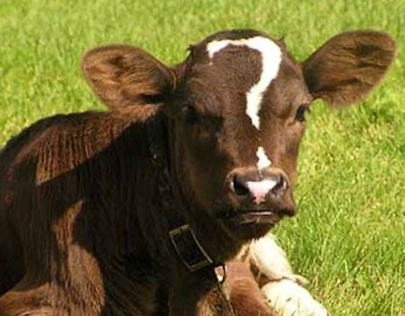
Questions?
Steve Spence, Charity Elijah, Cameron Croghan

Slide 23
References
Whip L, Daneshkhu, S. Big business identifies appetite for plant-based milk. Financial Times. July 15, 2016. http:// www.ft.com. Accessed September 14, 2017.
Hoffman J, Falvo M. Protein – Which is Best? Journal of Sports Science & Medicine. 2004;3(3):118-130.
Singhal S, Baker R, Baker S. A Comparison of the Nutritional Value of Cow’s Milk and Non-dairy Beverages. J Pediatr Gastroenterol Nutr. 2017 May;64(5):799-805.
USDA Food Composition Databases. Agricultural Research Service website. https://ndb.nal.usda.gov/ndb/search/list. Accessed August 2017.
USDA. Recent Trends in GE Adoption. Economic Research Service website. https://www.ers.usda.gov/data-products/ adoption-of-genetically-engineered-crops-in-the-us/recenttrends-in-ge-adoption.aspx. Updated July 2017. Accessed September 16, 2017.
Messina M. Soy and Health Update: Evaluation of the Clinical and Epidemiologic Literature. Nutrients. 2016;8(12):754.
Steve Spence, Charity Elijah, Cameron Croghan

Slide 24
References Continues
Jiang S, Cai W, Xu B. Food Quality Improvement of Soy Milk Made from Short-Time Germinated Soybeans. Foods. 2013;2(2):198-212.
Krader, Kate. For One Silicon Valley Startup, This Vegetable Is the Future of Milk. Bloomberg. September 12, 2017. http://www.bloomberg.com. Accessed October 12, 2017.
https://nutrition.org/going-nuts-about-milk-heres-what-you-need-to-know-about-plant-based-milk-alternatives/
https://www.forbes.com/sites/nomanazish/2019/04/29/dairy-vs-non-dairy-whats-best-for-you/#1ce73a58d90e
https://superfoodsrx.com/healthyliving/milk-vs-non-dairy-milk/
Steve Spence, Charity Elijah, Cameron Croghan

